Slide 1
Combinational ATPG
ATPG problem
Example
Algorithms
  Multi-valued algebra
  D-algorithm
  Podem
  Other algorithms
ATPG system
Summary

Slide 2
ATPG Problem
ATPG: Automatic test pattern generation
  Given
    A circuit (usually at gate-level)
    A fault model (usually stuck-at type)
  Find
    A set of input vectors to detect all modeled faults.
Core solution: Find a test vector for a given fault.
Combine the “core solution” with a fault simulator into an ATPG system.

Slide 3
What is a Test?
Fault activation
Fault effect
X
1
0
0
1
0
1
X
X
Combinational circuit
1/0
1/0
Primary inputs
(PI)
Primary outputs
(PO)
Path sensitization
Stuck-at-0 fault

Slide 4
Multiple-Valued Algebras
Symbol
D
D
0
1
X
G0
G1
F0
F1
Alternative
Representation
1/0
0/1
0/0
1/1
X/X
0/X
1/X
X/0
X/1
Fault-free
circuit
1
0
0
1
X
0
1
X
X
Faulty
Circuit
0
1
0
1
X
X
X
0
1
Roth’s
Algebra
Muth’s
Additions

Slide 5
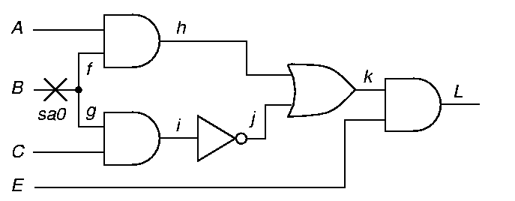
An ATPG Example
Fault activation
Path sensitization
Line justification
1
D

Slide 6
ATPG Example (Cont.)
Fault activation
Path sensitization
Line justification
Path from fault site to a primary output
D
D
1
D
D

Slide 7
ATPG Example (Cont.)
Fault activation
Path sensitization
Line justification
1
D
D
1
D
Conflict
0
D
1
1
1
1

Slide 8
ATPG Example (Cont.)
Fault activation
Path sensitization
Line justification
Backtrack
0
An alternative path sensitized
0
D
1
D
D
1
D
D
1
Test found

Slide 9
D-Algorithm (Roth 1967)
Use D-algebra
Activate fault
    Place a D or D at fault site
    Justify all signals
Repeatedly propagate D-chain toward POs through a gate
    Justify all signals
Backtrack if
    A conflict occurs, or
    All D-chains die
Stop when
    D or D at a PO, i.e., test found, or
    Search exhausted, no test possible

Slide 10
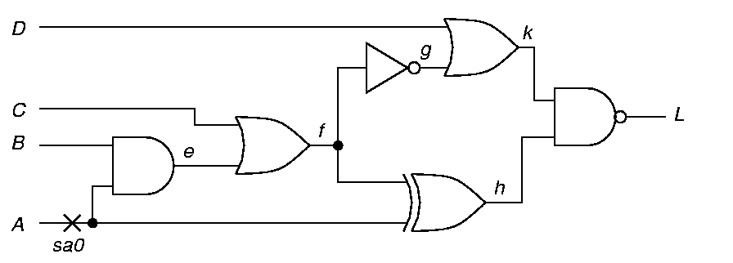
Example: Fault A sa0
Step 1 – Fault activation – Set A = 1
D
1
D
D-frontier = {e, h}

Slide 11
Example Continued
Step 2 – D-Drive – Set f = 0
0
D
1
D
D

Slide 12
Example Continued
Step 3 – D-Drive – Set k = 1
1
D
0
D
1
D
D

Slide 13
Example Continued
Step 4 – Consistency – Set g = 1
1
1
D
0
D
1
D
D

Slide 14
Example Continued
Step 5 – Consistency – f = 0 Already set
1
1
D
0
D
1
D
D

Slide 15
Example Continued
Step 6 – Consistency – Set c = 0, Set e = 0
1
0
1
D
0
0
D
1
D
D

Slide 16
Example: Test Found
Step 7 – Consistency – Set B = 0
Test: A = 1, B = 0, C = 0, D = X
X
1
0
1
D
0
0
0
D
1
D
D

Slide 17
Podem (Goel, 1981)
Podem: Path oriented decision making
Step 1: Define an objective (fault activation, D-drive, or line justification)
Step 2: Backtrace from site of objective to PIs (use testability measures guidance) to determine a value for a PI
Step 3: Simulate logic with new PI value
    If objective not accomplished but is possible, then continue backtrace to another PI (step 2)
    If objective accomplished and test not found, then define new objective (step 1)
    If objective becomes impossible, try alternative backtrace (step 2)
Use X-PATH-CHECK to test whether D-frontier still there – a path of X’s from a D-frontier to a PO must exist.

Slide 18
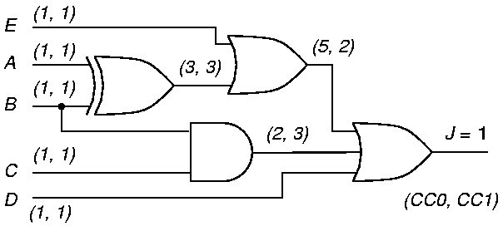
Podem Example
3. Logic simulation for A=0
2. Backtrace “A=0”
1. Objective “0”
0
S-a-1
(9, 2)
4. Objective possible but not accomplished

Slide 19
Podem Example (Cont.)
6. Logic simulation for A=0, B=0
5. Backtrace “B=0”
1. Objective “0”
0
0
0
S-a-1
0
(9, 2)
7. Objective possible but not accomplished

Slide 20
Podem Example (Cont.)
9. Logic simulation for E=0
8. Backtrace “E=0”
1. Objective “0”
0
0
0
0
0
S-a-1
0
(9, 2)
10. Objective possible but not accomplished

Slide 21
Podem Example (Cont.)
12. Logic simulation for D=0
1. Objective “0”
0
0
0
0
0
S-a-1
0
0
(9, 2)
0
13. Objective accomplished
11. Backtrace “D=0”

Slide 22
An ATPG System
Random pattern
generator
Fault simulator
yes
Fault
coverage
improved?
Random
patterns
effective?
Deterministic
ATPG (D-alg.
or Podem)
Save
patterns
yes
no
no
Stop if fault coverage goal achieved

Slide 23
Summary
Most combinational ATPG algorithms use D-algebra.
D-Algorithm is a complete algorithm:
    Finds a test, or
    Determines the fault to be redundant
    Complexity is exponential in circuit size
Podem is also a complete algorithm:
    Works on primary inputs – search space is smaller than that of D-algorithm
    Exponential complexity, but several orders faster than D-algorithm
More efficient algorithms available – FAN, Socrates, etc.
    See, M. L. Bushnell and V. D. Agrawal, Essentials of Electronic Testing for Digital, Memory and Mixed-Signal VLSI Circuits, Springer, 2000, Chapter 7.

Slide 24
Sequential ATPG

Slide 25
Sequential ATPG
A sequential circuit has memory in addition to combinational logic.
Test for a fault in a sequential circuit is a sequence of vectors, which
    Initializes the circuit to a known state
    Activates the fault, and
    Propagates the fault effect to a primary output
Methods of sequential circuit ATPG
    Time-frame expansion methods
    Simulation-based methods

Slide 26
Example: A Serial Adder
A_{n}
B_{n}
1
1
s-a-0
D
1
1
D
X
C_{n}
C_{n+1}
X
Combinational logic
1
S_{n}
X
FF

Slide 27
Time-Frame Expansion
A_{n-1}
B_{n-1}
Time-frame -1
A_{n}
B_{n}
Time-frame 0
1
1
1
1
s-a-0
D
s-a-0
X
D
D
1
1
C_{n-1}
1
D
X
C_{n}
1
D
1
C_{n+1}
X
1
Combinational logic
Combinational logic
1
S_{n-1}
S_{n}
X
D
FF

Slide 28
Concept of Time-Frames
If the test sequence for a single stuck-at fault contains n vectors,
    Replicate combinational logic block n times
    Place fault in each block
    Generate a test for the multiple stuck-at fault using combinational ATPG with 9-valued logic
Vector -n+1
Vector -1
Vector 0
Fault
Unknown
or given
Init. state
Time-
frame
-n+1
State
variables
Time-
frame
0
Next
state
Time-
frame
-1
Comb.
block
PO -n+1
PO -1
PO 0

Slide 29
Example for Logic Systems
FF1
B
A
FF2
s-a-1

Slide 30
Five-Valued Logic (Roth)
0,1, D, D, X
A
0
A
0
s-a-1
s-a-1
D
D
X
X
X
FF1
FF1
X
D
D
FF2
FF2
B
X
B
X
Time-frame -1
Time-frame 0

Slide 31
Nine-Valued Logic (Muth)
0,1, 1/0, 0/1, 1/X, 0/X, X/0, X/1, X
A
0
A
X
s-a-1
s-a-1
0/1
X/1
X
0/X
0/X
FF1
FF1
X
0/1
X/1
FF2
FF2
B
X
B
0/1
Time-frame -1
Time-frame 0

Slide 32
Implementation of ATPG
Select a PO for fault detection based on drivability analysis.
Place a logic value, 1/0 or 0/1, depending on fault type and number of inversions.
Justify the output value from PIs, considering all necessary paths and adding backward time-frames.
If justification is impossible, then use drivability to select another PO and repeat justification.
If the procedure fails for all reachable POs, then the fault is untestable.
If 1/0 or 0/1 cannot be justified at any PO, but 1/X or 0/X can be justified, the the fault is potentially detectable.

Slide 33
Drivability Example
(11, 16)
(10, 15)
(22, 17)
(10, 16)
d(0/1) =
d(1/0) = 32
s-a-1
8
d(0/1) = 4
d(1/0) =
d(0/1) =
d(1/0) = 20
8
8
(4, 4)
(5, 9)
(17, 11)
d(0/1) = 9
d(1/0) =
(6, 10)
(CC0, CC1)
= (6, 4)
8
FF
d(0/1) = 120
d(1/0) = 27
d(0/1) = 109
d(1/0) =
8
CC0 and CC1 are SCOAP combinational controllabilities
d(0/1) and d(1/0) of a line are effort measures for driving
a specific fault effect to that line

Slide 34
Complexity of ATPG
Synchronous circuit – All flip-flops controlled by clocks; PI and PO synchronized with clock:
    Cycle-free circuit – No feedback among flip-flops: Test generation for a fault needs no more than dseq + 1 time-frames, where dseq is the sequential depth.
    Cyclic circuit – Contains feedback among flip-flops: May need 9^{Nff} time-frames, where Nff is the number of flip-flops.
Asynchronous circuit – Higher complexity!
Smax
Time-
Frame
max-1
Time-
Frame
max-2
S3
Time-
Frame
-2
S2
Time-
Frame
-1
S1
Time-
Frame
0
S0
max = Number of distinct vectors with 9-valued elements = 9^{Nff}

Slide 35
Cycle-Free Circuits
Characterized by absence of cycles among flip-flops and a sequential depth, dseq.
dseq is the maximum number of flip-flops on any path between PI and PO.
Both good and faulty circuits are initializable.
Test sequence length for a fault is bounded by dseq + 1.

Slide 36
A Cycle-Free Circuit Example
Circuit
F2
2
All faults are
testable in
this circuit.
F3
F1
Level = 1
3
F2
2
s - graph
F1
F3
dseq = 3
Level = 1
3

Slide 37
A Cyclic Circuit Example
Modulo-3 counter
Z
CNT
F2
F1
s - graph
F1
F2

Slide 38
Modulo-3 Counter
Cyclic structure – Sequential depth is undefined.
Circuit is not initializable. No tests can be generated for any stuck-at fault.
After expanding the circuit to 9^{Nff} = 81, or fewer, time-frames ATPG program calls any given target fault untestable.
Circuit can only be functionally tested by multiple observations.
Functional tests, when simulated, give no fault coverage.

Slide 39
Adding Initializing Hardware
Initializable modulo-3 counter
Z
CNT
F2
F1
s-a-0
s-a-1
CLR
s-a-1
s-a-1
Untestable fault
Potentially detectable faults
s - graph
F1
F2

Slide 40
Benchmark Circuits
Circuit
PI
PO
FF
Gates
Structure
Seq. depth
Total faults
Detected faults
Potentially detected faults
Untestable faults
Abandoned faults
Fault coverage (%)
Fault efficiency (%)
Max. sequence length
Total test vectors
Gentest CPU s (Sparc 2)
s1196
14
14
18
529
Cycle-free
4
1242
1239
0
3
0
99.8
100.0
3
313
10
s1238
14
14
18
508
Cycle-free
4
1355
1283
0
72
0
94.7
100.0
3
308
15
s1488
8
19
6
653
Cyclic
--
1486
1384
2
26
76
93.1
94.8
24
525
19941
s1494
8
19
6
647
Cyclic
--
1506
1379
2
30
97
91.6
93.4
28
559
19183

Slide 41
Summary
Combinational ATPG algorithms are extended:
    Time-frame expansion unrolls time as combinational array
    Nine-valued logic system
    Justification via backward time
Cycle-free circuits:
    Require at most dseq + 1 time-frames
    Always initializable
Cyclic circuits:
    May need 9^{Nff} time-frames
    Circuit must be initializable
    Partial scan can make circuit cycle-free
Asynchronous circuits: Not discussed
    See, M. L. Bushnell and V. D. Agrawal, Essentials of Electronic Testing for Digital, Memory and Mixed-Signal VLSI Circuits, Springer, 2000, Chapter 8.

Slide 42
Exercise 4
s-a-1
For the circuit shown above
    Derive a test for the stuck-at-1 fault at the output of the AND gate.
    Using the parallel fault simulation algorithm, determine which of the four primary input faults are detectable by the test derived above.

Slide 43
Exercise 4: Answer
■ A test for the stuck-at-1 fault shown in the diagram is 00.
0
0
D
D
0
s-a-1

Slide 44
Exercise 4: Answer Continued
■ Parallel fault simulation of four PI faults is illustrated below.
Fault PI2 s-a-1 is detected by the 00 test input.
0 0 1 0 0
0 0 0 0 0
PI1=0
0 0 0 0 1
0 0 0 0 1
PI2=0
0 0 0 0 1
No fault
PI1 s-a-0
PI1 s-a-1
PI2 s-a-0
PI2 s-a-1
0 0 0 0 1
PI2 s-a-1 detected

Slide 45
Timing and Delay Tests

Slide 46
Delay Test Definition
A circuit that passes delay test must produce correct outputs when inputs are applied and outputs observed with specified timing.
For a combinational or synchronous sequential circuit, delay test verifies the limits of delay in combinational logic.
Delay test problem for asynchronous circuits is complex and not well understood.

Slide 47
Digital Circuit Timing
Input
Signal
changes
Output
Observation
instant
Transient
region
Comb.
logic
Inputs
Synchronized
With clock
Outputs
time
Clock period

Slide 48
Circuit Delays
Switching or inertial delay is the interval between input change and output change of a gate:
    Depends on input capacitance, device (transistor) characteristics and output capacitance of gate.
    Also depends on input rise or fall times and states of other inputs (second-order effects).
    Approximation: fixed rise and fall delays (or min-max delay range, or single fixed delay) for gate output.
Propagation or interconnect delay is the time a transition takes to travel between gates:
    Depends on transmission line effects (distributed R, L, C parameters, length and loading) of routing paths.
    Approximation: modeled as lumped delays for gate inputs.
See logic simulation for timing models.

Slide 49
Event Propagation Delays
Single lumped inertial delay modeled for each gate
PI transitions assumed to occur without time skew
Path P1
1 3
0
1
P2
2 4 6
1
0
2
3
P3
0
2
5

Slide 50
Delay Test Generation Problem: Variations in CMOS Delays
Switching delays in CMOS greatly depend on the off path signals and internal circuit state
Hard to find <V₁, V₂> to ensure worst case conditions for signal propagation along a path.
Often this worst case test vector pair can be different for the same circuit depending on fabrication parameters
A
B
C
output
A
B
C

Slide 51
Circuit Outputs
Each path can potentially produce one signal transition at the output.
The location of an output transition in time is determined by the delay of the path.
Clock period
Final value
Initial value
Fast transitions
Slow transitions
Initial value
Final value
time

Slide 52
The Transition Delay Fault (TDF) model
Assumes a single localized gross delay fault at some node
Faulty node is either slow-to-rise or slow-to- fall
For an N node circuit, 2N faults in the fault list
Tested by 2-vector test <V1, V2> where the vector pair is selected to cause a rising (falling) transition at the node to test for a slow-to-rise (slow-to-fall) fault; also V2 is a stuck-at-0 (stuck-at-1) test for the node

Slide 53
Singly-Testable Paths
(Non-Robust Test)
The delay of a target path is tested if the test propagates a transition via path to a path destination.
Delay test is a combinational vector-pair, V1,V2, that:
    Produces a transition at path input.
    Produces static sensitization – All off-path inputs assume non-controlling states in V2.
don’t
care
V1 V2
Off-path inputs
V1 V2
Target
path
Static sensitization guarantees a test when the target path is the only faulty path. The test is, therefore, called non-robust. It is a test with minimal restriction.
A path with no such test is a false path.

Slide 54
Robust Test
A robust test guarantees the detection of a delay fault of the target path, irrespective of delay faults on other paths.
A robust test is a combinational vector-pair, V1, V2, that satisfies following conditions:
    Produce real events (different steady-state values for V1 and V2) on all on-path signals.
    All on-path signals must have controlling events arriving via the target path.
A robust test is also a non-robust test.
Concept of robust test is general – robust tests for other fault models can be defined.

Slide 55
Robust Test Conditions
Real events on target path.
Controlling events via target path.
V1 V2
V1 V2
V1 V2
U0
V1 V2
U1
U0
U1
U1/R1
U0/F0
U0/F0
U1/R1
V1 V2
V1 V2
S1
S0
S1
S0
U0/F0
U0/F0
U1/R1
U1/R1

Slide 56
A Five-Valued Algebra
Signal States: S0, U0 (F0), S1, U1 (R1), XX.
On-path signals: F0 and R1.
Off-path signals: F0=U0 and R1=U1.
Input 1
Input 1
AND
S0 U0 S1 U1 XX
S0 S0 S0 S0 S0 S0
U0 S0 U0 U0 U0 U0
S1 S0 U0 S1 U1 XX
U1 S0 U0 U1 U1 XX
XX S0 U0 XX XX XX
OR
S0 U0 S1 U1 XX
S0 S0 U0 S1 U1 XX
U0 U0 U0 S1 U1 XX
S1 S1 S1 S1 S1 S1
U1 U1 U1 S1 U1 U1
XX XX XX S1 U1 XX
Input 2
Input 2
Input
S0 U0 S1 U1 XX
S1 U1 S0 U0 XX
NOT
Ref.:
Lin-Reddy
IEEETCAD-87

Slide 57
Robust Test Generation
Test for ↓ P3 – falling transition through path P3: Steps A through E
E. Set input of AND gate to
S0 to justify S0 at output
XX S0
S0
U0
C. F0 interpreted as U0;
propagates through
AND gate
D. Change off-path input
to S0 to Propagate R1
through OR gate
U0
A. Place F0 at
path origin
R1
Path P3
F0
XX
F0
R1
U0
Robust Test:
S0, F0, U0
B. Propagate F0 through OR gate;
also propagates as R1 through
NOT gate

Slide 58
Non-Robust Test Generation
Fault ↑ P2 – rising transition through path P2 has no robust test.
C. Set input of AND gate to
propagate R1 to output
D. R1 non-robustly propagates
through OR gate since off-
path input is not S0
XX U1
R1
R1
Path P2
U1
A. Place R1 at
path origin
R1
R1
U1
U0
Non-robust test requires
Static sensitization:
S0=U0, S1=U1
XX
U0
B. Propagate R1 through OR gate;
interpreted as U1 on off-path signal;
propagates as U0 through NOT gate
Non-robust test:
U1, R1, U0

Slide 59
Path-Delay Faults (PDF)
Two PDFs (rising and falling transitions) for each physical path.
Total number of paths is an exponential function of gates. Critical paths, identified by static timing analysis (e.g., Primetime from Synopsys), must be tested.
PDF tests are delay-independent. Robust tests are preferred, but some paths have only non-robust tests.
Three types of PDFs (Gharaybeh, et al., JETTA (11), 1997):
    Singly-testable PDF – has a non-robust or robust test.
    Multiply-testable PDF – a set of singly untestable faults that has a non-robust or robust test. Also known as functionally testable PDF.
    Untestable PDF – a PDF that is neither singly nor multiply testable.
A singly-testable PDF has at least one single-input change (SIC) non-robust test.

Slide 60
Other Delay Fault Models
Segment-delay fault – A segment of an I/O path is assumed to have large delay such that all paths containing the segment become faulty.
Transition fault – A segment-delay fault with segment of unit length (single gate):
    Two faults per gate; slow-to-rise and slow-to-fall.
    Tests are similar to stuck-at fault tests. For example, a line is initialized to 0 and then tested for s-a-0 fault to detect slow-to-rise transition fault.
    Models spot (or gross) delay defects.
Line-delay fault – A transition fault tested through the longest delay path. Two faults per line or gate. Tests are dependent on modeled delays of gates.
Gate-delay fault – A gate is assumed to have a delay increase of certain amount (called fault size) while all other gates retain some nominal delays. Gate-delay faults only of certain sizes may be detectable.

Slide 61
At-Speed Test
At-speed test means application of test vectors at the rated-clock speed.
Two methods of at-speed test.
External test:
    Vectors may test one or more functional critical (longest delay) paths and a large percentage (~100%) of transition faults.
    High-speed testers are expensive.
Built-in self-test (BIST):
    Hardware-generated random vectors applied to combinational or sequential logic.
    Only clock is externally supplied.
    Non-functional paths that are longer than the functional critical path can be activated and cause a good circuit to fail.
    Some circuits have initialization problem.

Slide 62
Timing Design & Delay Test
Timing simulation:
    Critical paths are identified by static (vector-less) timing analysis tools like Primetime (Synopsys).
    Timing or circuit-level simulation using designer-generated functional vectors verifies the design.
Layout optimization: Critical path data are used in placement and routing. Delay parameter extraction, timing simulation and layout are repeated for iterative improvement.
Testing: Some form of at-speed test is necessary. PDFs for critical paths and all transition faults are tested.

Slide 63
Problems with Delay Test Application in a Scan Environment
  Even if good delay test vectors can be generated, scan can only support very limited two vector test patterns
    launch-on-shift (“skewed load”)
    launch-on-capture (“broad side”)
  Many desired delay timing tests may be impossible to apply in a scan environment.

Slide 64
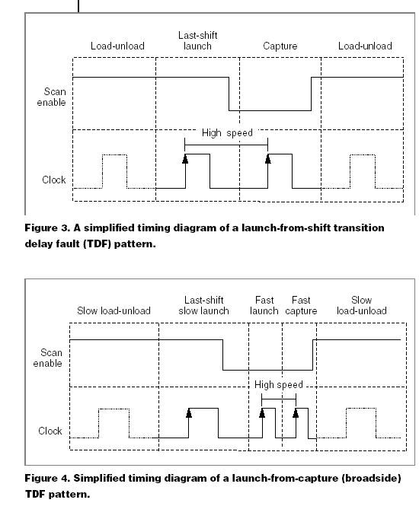
Launch-on-Shift
Scan Based Delay Testing
LOGIC
Data In
Data Out
V1
M
U
X
Flip
Flop
Scan In
V2
Scan
Enable
Clock
Clock Edge 1: Launch V2 (scan = 1)
Then switch scan = 0
Clock Edge 2: Capture response to V1 → V2
change in Flip Flop

Slide 65
Launch-on-Capture
Scan Based Delay Testing
LOGIC
Data In
Data Out
V2 =
Response[V1]
V1
M
U
X
Flip
Flop
Scan In
Clock Edge 1: Apply V1 (scan = 1)
Then switch scan = 0
Clock Edge 2: Capture response to V1 in
Flip Flop to launch timed
transition. This is V2
Clock Edge 3: Capture response to V2
Scan
Enable
Clock

Slide 66
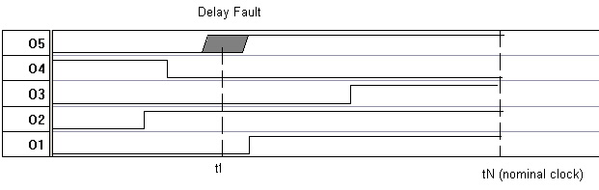
Problems with Testing for Timing Fails at Functional Clock Rate
Timing Margin
<V₁V₂>
critical path
  Timing margins to allow for parameter variations, clock skew, variations in test conditions can make “small” defects undetectable.

Slide 67
minVDD Testing
minVDD is found by repeatedly running the test vectors at different VDD voltages and performing a binary search until the failing voltage is identified within desired accuracy
Since binary searches on full vector sets can be expensive, methods have been developed to work with reduced test sets.
Notes:
View it as a slide show first. It will highlight important aspects of your presentation, and give you an example of a presentation that lives up to ITC presentation standards and guidelines.
Virus checker: When we created this presentation guide it contained no known viruses. This file was checked by McAfee VShield 4.x software before being distributed to authors. You should use a good, up to date virus checker on this file, and any other file you import from an outside source. Make sure your virus checker’s data files are up to date, too. Keep in mind: the version of this file you are reading may be different from the version we checked!
Confidentiality: We respect your copyright, and do not distribute your presentation before the conference. However, we cannot promise strict confidentiality of your presentation before the conference, because others have read access to our FTP sites. Do not include confidential information in your presentation.
Test Slide: A test slide is included as a “hidden slide” after the end of this presentation. If you want to do a trial projection, ensure that your projector projects the entire slide, and that aspect ratios are correct. We will use the same test slide at the conference for setup of our projection equipment.

Slide 68
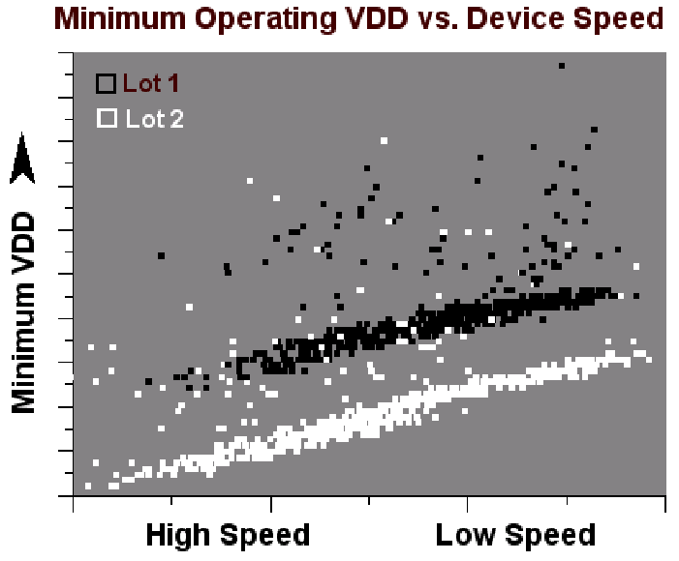
MinVDD vs Device Speed
Two different lots showing min VDD outliers and lot-to-lot intrinsic variation.

Slide 69
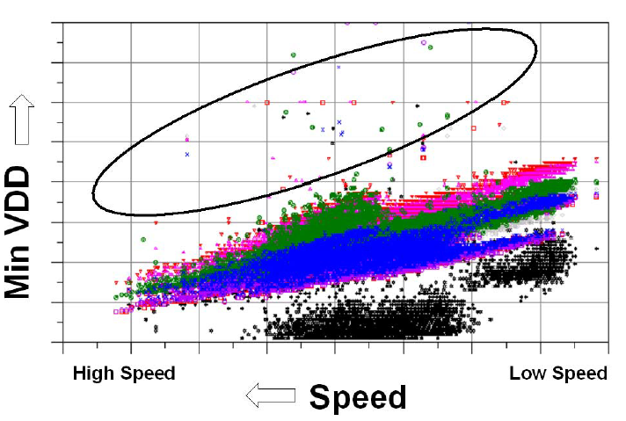
minVDD Testing
Minimum VDD results for different functional tests clearly showing min VDD outliers (circled)

Slide 70
Fmax Testing
Fmax Testing finds the highest clock rate for which a circuit passes a given (TDF) test set
A binary search using repeated applications of the test set is performed to obtain Fmax
Again an abnormal Fmax value compared to neighbors indicates a defect that may cause a functional or reliability failure in the field
Notes:
View it as a slide show first. It will highlight important aspects of your presentation, and give you an example of a presentation that lives up to ITC presentation standards and guidelines.
Virus checker: When we created this presentation guide it contained no known viruses. This file was checked by McAfee VShield 4.x software before being distributed to authors. You should use a good, up to date virus checker on this file, and any other file you import from an outside source. Make sure your virus checker’s data files are up to date, too. Keep in mind: the version of this file you are reading may be different from the version we checked!
Confidentiality: We respect your copyright, and do not distribute your presentation before the conference. However, we cannot promise strict confidentiality of your presentation before the conference, because others have read access to our FTP sites. Do not include confidential information in your presentation.
Test Slide: A test slide is included as a “hidden slide” after the end of this presentation. If you want to do a trial projection, ensure that your projector projects the entire slide, and that aspect ratios are correct. We will use the same test slide at the conference for setup of our projection equipment.

Slide 71
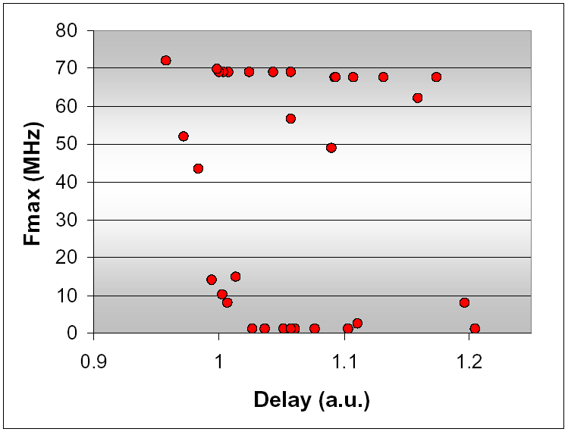
Fmax Testing
Intrinsic Clock
Operational Clock
Fmax for TDF pattern for 32 parts that pass
dc tests but fail system level tests

Slide 72
Stress Testing
ICs also experience significant early life or “infant mortality” failures (0.2-2%)
Infant mortality results from latent manufacturing flaws that are undetectable at initial wafer probe testing
Important to screen out such failures using accelerated life cycle or stress tests
Burn-in tests exercise circuits at elevated voltages and temperatures for a few hours up to a few days in temperature controlled burn-in “ovens”
Notes:
View it as a slide show first. It will highlight important aspects of your presentation, and give you an example of a presentation that lives up to ITC presentation standards and guidelines.
Virus checker: When we created this presentation guide it contained no known viruses. This file was checked by McAfee VShield 4.x software before being distributed to authors. You should use a good, up to date virus checker on this file, and any other file you import from an outside source. Make sure your virus checker’s data files are up to date, too. Keep in mind: the version of this file you are reading may be different from the version we checked!
Confidentiality: We respect your copyright, and do not distribute your presentation before the conference. However, we cannot promise strict confidentiality of your presentation before the conference, because others have read access to our FTP sites. Do not include confidential information in your presentation.
Test Slide: A test slide is included as a “hidden slide” after the end of this presentation. If you want to do a trial projection, ensure that your projector projects the entire slide, and that aspect ratios are correct. We will use the same test slide at the conference for setup of our projection equipment.

Slide 73
Screening for Burn-in
Minimization
High end circuits have nanometer feature sizes and operate on low voltages
Stress voltages and temperatures must be carefully (individually) controlled to avoid damaging the circuits >> expensive ovens
Needed burn-in times are growing because voltage/temperature stress levels can only be marginally increased from the nominal
Some defect types do not accelerate in burn-in
Statistical outlier screening is now being also used to minimize burn-in
Notes:
View it as a slide show first. It will highlight important aspects of your presentation, and give you an example of a presentation that lives up to ITC presentation standards and guidelines.
Virus checker: When we created this presentation guide it contained no known viruses. This file was checked by McAfee VShield 4.x software before being distributed to authors. You should use a good, up to date virus checker on this file, and any other file you import from an outside source. Make sure your virus checker’s data files are up to date, too. Keep in mind: the version of this file you are reading may be different from the version we checked!
Confidentiality: We respect your copyright, and do not distribute your presentation before the conference. However, we cannot promise strict confidentiality of your presentation before the conference, because others have read access to our FTP sites. Do not include confidential information in your presentation.
Test Slide: A test slide is included as a “hidden slide” after the end of this presentation. If you want to do a trial projection, ensure that your projector projects the entire slide, and that aspect ratios are correct. We will use the same test slide at the conference for setup of our projection equipment.

Slide 74
Summary
Path-delay fault (PDF) models distributed delay defects. It verifies the timing performance of a manufactured circuit.
Transition fault models spot delay defects and is testable by modified stuck-at fault tests.
Variable-clock method can test delay faults but the test time can be long.
Critical paths of non-scan sequential circuits can be effectively tested by rated-clock tests.
Delay test methods (including BIST) for non-scan sequential circuits using slow ATE require investigation:
    Suppression of non-functional path activation in BIST.
    Difficulty of rated-clock PDF test generation.
    Long sequences of variable-clock tests.

Slide 75
I_{DDQ} Current Testing

Slide 76
Motivation
Early 1990’s – Fabrication Line had 50 to 1000 defects per million (dpm) chips
  IBM wants to get 3.4 defects per million (dpm) chips (0 defects, 6 σ)
Conventional way to reduce defects:
  Increasing test fault coverage
  Increasing burn-in coverage
  Increase Electro-Static Damage awareness
New way to reduce defects:
  I_{DDQ} Testing – also useful for Failure Effect Analysis

Slide 77
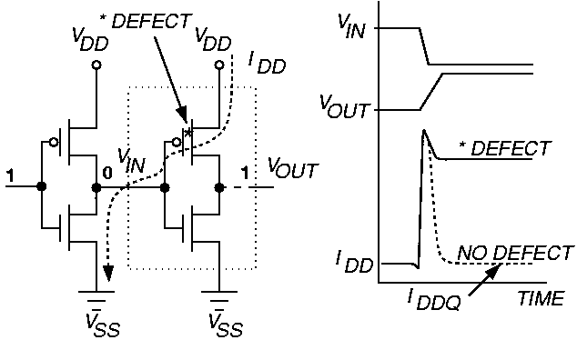
Principle of I_{DDQ} Testing
  Measure I_{DDQ} current through V_{ss} bus

Slide 78
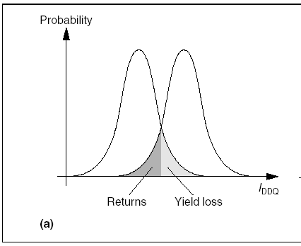
Idealized IDDQ Probability Distribution Function for Good and Bad chips
Current threshold
Trade-off between field returns (DPM) and yield loss

Slide 79
Stuck-at Faults Detected by I_{DDQ} Tests
Bridging faults with stuck-at fault behavior
  Levi – Bridging of a logic node to V_{DD} or V_{SS} – few of these
  Transistor gate oxide short of 1 kΩ to 5 kΩ
Floating MOSFET gate defects – do not fully turn off transistor

Slide 80
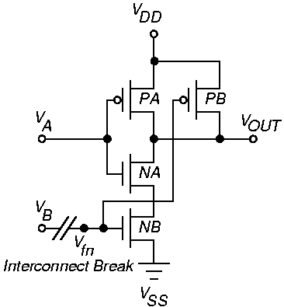
NAND Open Circuit Defect – Floating gate

Slide 81
Floating Gate Defects
Small break in logic gate inputs (100 – 200 Angstroms) lets wires couple by electron tunneling
  Delay fault and I_{DDQ} fault
Large open results in stuck-at fault – not detectable by I_{DDQ} test
  If V_{tn} < V_{fn} < V_{DD} - | V_{tp} | then detectable by I_{DDQ} test

Slide 82
Delay Faults
Most random CMOS defects cause a timing delay fault, not catastrophic failure
Many delay faults detected by I_{DDQ} test – late switching of logic gates keeps I_{DDQ} elevated
Delay faults not detected by I_{DDQ} test
  Resistive via fault in interconnect
  Increased transistor threshold voltage fault

Slide 83
Leakage Faults
Gate oxide shorts cause leaks between gate & source or gate & drain
Mao and Gulati leakage fault model:
  Leakage path flags: f_{GS}, f_{GD}, f_{SD}, f_{BS}, f_{BD}, f_{BG} G = gate, S = source, D = drain, B = bulk
Assume that short does not change logic values

Slide 84
Weak Faults
nFET passes logic 1 as 5 V – V_{tn}
pFET passes logic 0 as 0 V + |V_{tp}|
Weak fault – one device in C-switch does not turn on
  Causes logic value degradation in C-switch

Slide 85
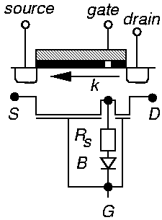
Gate Oxide Short

Slide 86
Instrumentation Problems
Need to measure < 1 μA current at clock > 10 kHz
Off-chip I_{DDQ} measurements degraded
  Pulse width of CMOS IC transient current
  Impedance loading of tester probe
  Current leakages in tester
  High noise of tester load board
Much slower rate of current measurement than voltage measurement

Slide 87
Sematech Study
IBM Graphics controller chip – CMOS ASIC, 166,000 standard cells
0.8 mm static CMOS, 0.45 μm Lines (L_{eff}), 40 to 50 MHz Clock, 3 metal layers, 2 clocks
Full boundary scan on chip
Tests:
  Scan flush – 25 ns latch-to-latch delay test
  99.7 % scan-based stuck-at faults (slow 400 ns rate)
  52 % SAF coverage functional tests (manually created)
  90 % transition delay fault coverage tests
  96 % pseudo-stuck-at fault cov. I_{DDQ} Tests

Slide 88
Sematech Results
Test process: Wafer Test → Package Test →
Burn-In & Retest → Characterize & Failure Analysis
Data for devices failing some, but not all, tests.
IDDQ (5 μA limit)
pass
14
6
52
pass
pass
6
0
1
36
fail
fail
1463
34
13
1251
pass
fail
7
1
8
fail
pass
fail
pass
fail
pass
pass
fail
fail
Scan-based Stuck-at
Scan-based delay
Functional

Slide 89
Sematech Conclusions
Hard to find point differentiating good and bad devices for I_{DDQ} & delay tests
High # passed functional test, failed all others
High # passed all tests, failed I_{DDQ} > 5 μA
Large # passed stuck-at and functional tests
  Failed delay & IDDQ tests
Large # failed stuck-at & delay tests
  Passed I_{DDQ} & functional tests
Delay test caught delays in chips at higher Temperature burn-in – chips passed at lower T.

Slide 90
Limitations of I_{DDQ} Testing
Sub-micron technologies have increased leakage currents
  Transistor sub-threshold conduction
  Harder to find I_{DDQ} threshold separating good and bad chips
I_{DDQ} tests work:
  When average defect-induced current greater than average good IC current
  Small variation in I_{DDQ} over test sequence and between chips
Now less likely to obtain two conditions

Slide 91
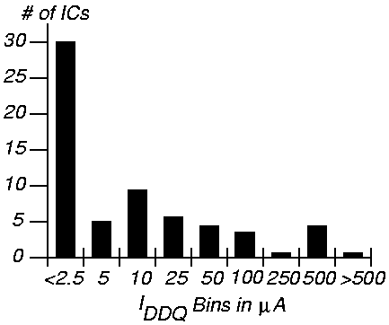
Current Limit Setting
Should try to get it < 1 μA
Histogram for 32 bit microprocessor

Slide 92
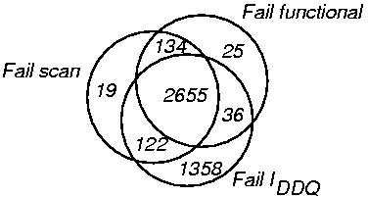
Failure Distribution in Hewlett-Packard Chip

Slide 93
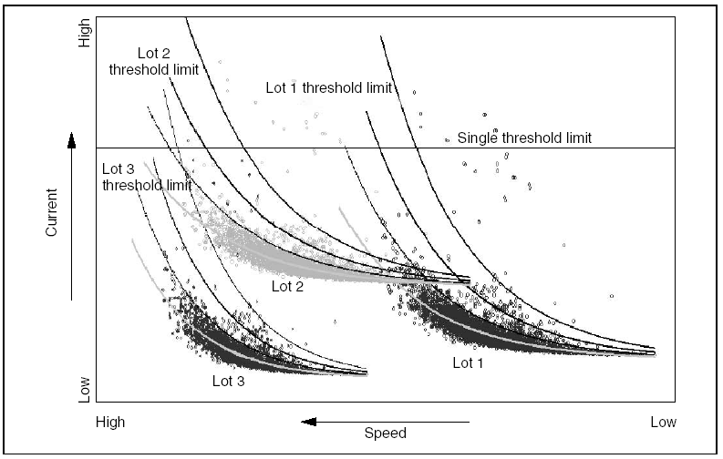
Three processing lots of IDDQ data for a single product.
The Problem with using a single IDDQ threshold

Slide 94
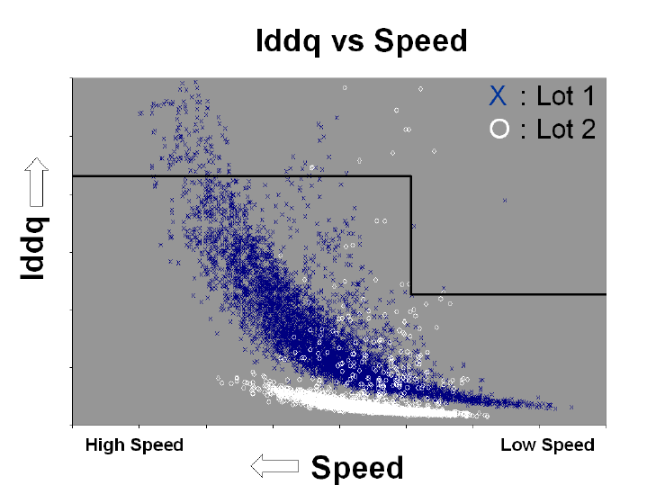
Stepped threshold IDDQ
Stepped threshold limits lead to unnecessary yield loss at faster end on LOT 1 but do not adequately screen outliers on the slower end especially on LOT 2. Both lots are the same product and were fabricated and tested at the same location

Slide 95
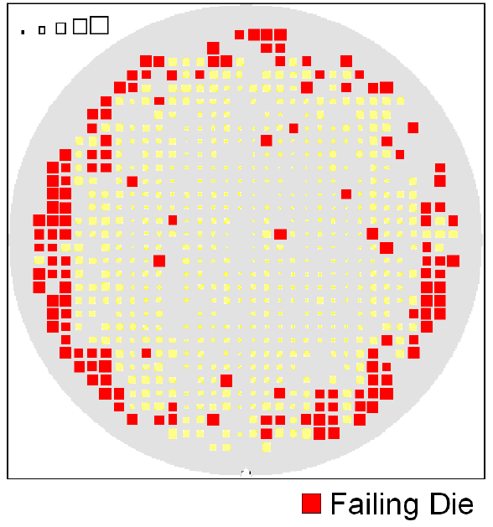
Single threshold IDDQ
Excessive yield loss is observed at wafer edge due to single threshold IDDQ limits

Slide 96
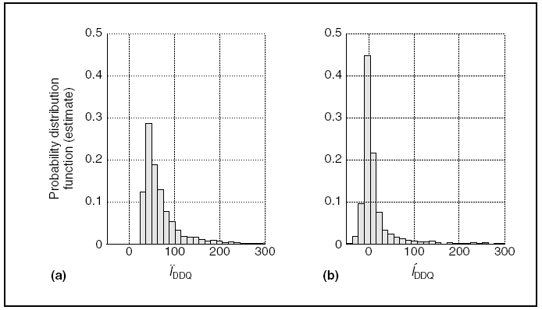
Neighborhood Selection for IDDQ Outlier Screening at Wafer Sort
Distribution variance: (a) original IDDQ measurements;
(b) improved variance resulting from nearest-neighbor estimation (b)

Slide 97
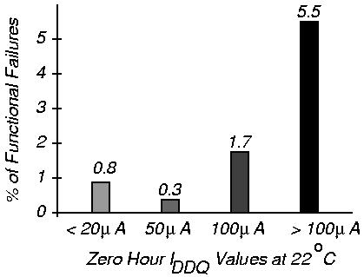
% Functional Failures After 100 Hours Life Test
Work of McEuen at Ford Microelectronics

Slide 98
I_{DDQ} Built-in Current Testing – Maly and Nigh
Build current sensor into ground bus of device-under-test
Voltage drop device and comparator
  Compares virtual ground V_{GND} with V_{ref} at end of each clock – V_{GND} > V_{ref} only in bad circuits
  Activates circuit breaker when bad device found

Slide 99
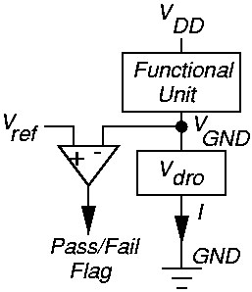
Conceptual BIC Sensor

Slide 100
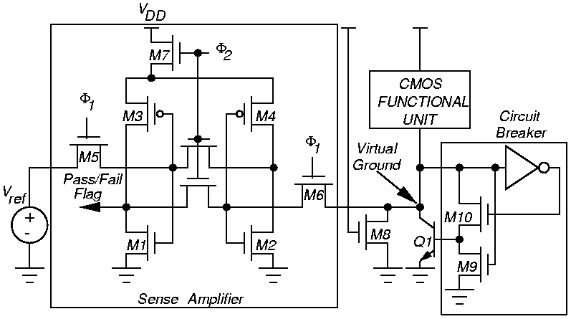
CMOS BIC Sensor

Slide 101
Summary
I_{DDQ} tests improve reliability, find defects causing:
  Delay, bridging, weak faults
  Chips damaged by electro-static discharge
No natural breakpoint for current threshold
  Get continuous distribution – bimodal would be better
Conclusion: now need stuck-fault, I_{DDQ}, and delay fault testing combined
Still uncertain whether I_{DDQ} tests will remain useful as chip feature sizes shrink further

